Slide 1
Object Avoiding Robot
Presented by
QuadSquad
1.Kedar Deepak Mule 22228
2.Sakshi Dattaram Gorivale 22117
3.Anirudha Milind Landage 22233
4.Abhijeet Laxman Shinde 22221

Slide 2
Content
Problem Statement
Motivation
Objective
Literature Review
Use Case Diagram
System Architecture
Conclusion
References
Applications
Implementation

Slide 3


Problem Statement
Object Avoiding Robot Using Arduino
The primary purpose of this bot is to traverse forward autonomously and change directions if it encounters any significant obstacle in its path. The bot will avoid any obstacle big enough to be detected by the ultrasonic sensors mounted on the front

Slide 4
Motivation
The motivation for this project is drawn from the desire to work on software as well as on hardware
The motivation for this project was to design a robot toy which would entertain the user of all the age groups. The goal was to detect an obstacle and if found, then change its direction automatically which involves the utilization of MSP430 along with other components like ultrasonic sensors, motors.

Slide 5
Objective
Obstacle avoidance robot is designed to allow robot to navigate in unknown environment by avoiding collisions.
Obstacle avoiding robot senses obstacles in the path, avoids it and resumes its running.
This project is designed to build an obstacle avoidance robotic vehicle using ultrasonic sensors.
A micro- controller (AT mega 8) is used to achieve the desired operation.

Slide 6
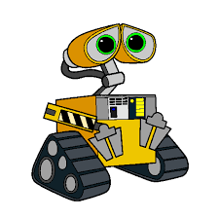
Literature Review
IFERP | NAME | DRAWABACKS | OVERCOMES
ISSN 2394-6849 | Autonomous Obstacle Avoidance Robot | IR sensors are used | Ultrasonic sensors are use
ISSN 2278-0181 | Obstacle Avoiding Robot Using Arduino | Car Robot (using 4 motors) | Balancing Robot (using 2 motors)

Slide 7
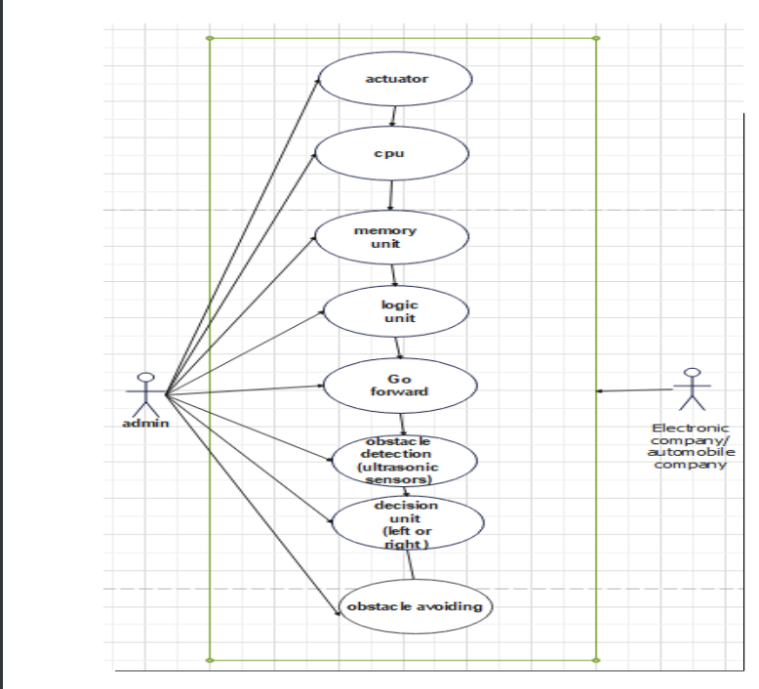
Case Diagram

Slide 8

System Architecture
We have selected the Arduino board as the microcontroller platform and its software counterpart to carry out the programming. The microcontroller can read input in the form of light or sound through a sensor and convert it into an output according to the instruction given by the Arduino programming.
The Arduino microcontroller can only be functional with the help of a code. To write this code, Arduino Software (IDE) is used which is also opensource like the Arduino Uno board. It is a software used by many for its simplicity and the ability to communicate with all Arduino boards. Arduino Software version 1.8.19 is used to write the code in C++ programming language which is then uploaded to the Arduino microcontroller through an USB cable. The software saves the code in a file with .ino extension.

Slide 9
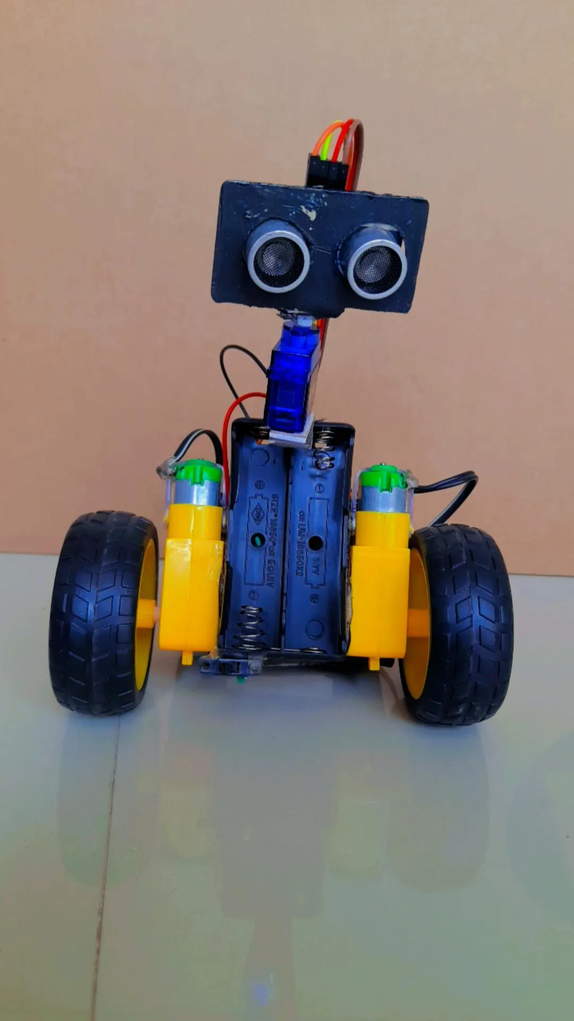
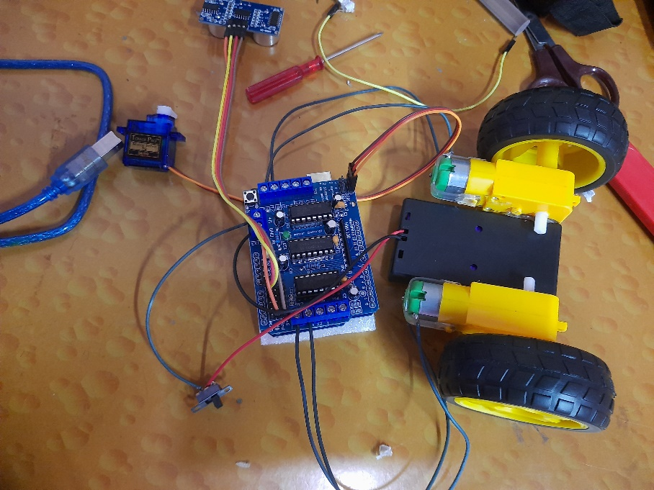
Implementation

Slide 10
Applications
Used in dangerous environment where human being can’t go
Mobile robot navigate system
Automatic vacuum cleaner
Back sonar of automobiles

Slide 11

Conclusion
The goal of our project is to create an autonomous robot which intelligently detects obstacle path and navigate conveniently according to the actions we set for it.

Slide 12
Future Work
A lot of things could be done to improve the performance and usage of this robot.
It would also be possible to add required functions to make this bot a fully functional guide bot for visually impaired and old people with visibility problems.
This robot will be helpful for visually impaired people to navigate and walk without worrying about colliding into obstacles.
Adding solar panels will help this bot to make itself self-sufficient and self-powering robot.
Improvements in algorithm will help the robot to reach the predetermined goal or location.
Indira College of Engineering Management, Parandwadi

Slide 13
References
Websites
http://www.datasheetcatalog.com
http://www.instructable.com
https://en.wikipedia.org/wiki/Artificial_intelligence
http://science.howstuffworks.com/robot2.html
https://arudino.cc/Main/arudinoBoardUno

Slide 14
Thank You!!!

